Slide 1

Presentation by:
Chakradhar

Slide 2


Slide 3

UML
UML stands for Unified Modeling Language.
UML is accepted by the Object Management Group (OMG) as the standard for modeling object oriented programs.
UML is a common language for creating models of Object Oriented Programming.

Slide 4
UML
An additional perspective
Who should use UML?
How and when should they use it?
Individual vs. group benefits

Slide 5
UML
Java is an Object Oriented language
Thinking with objects is different
How can we best teach objects?

Slide 6
UML
    Dealing with complexity
    Faster development
    Reuse
    Easier maintenance
The above are only achieved successfully through the proper application of quality object oriented analysis and design.

Slide 7
UML
Different members of the development team
Managers
  need to understand what everybody is doing
Analysts
  capture business needs and propose solutions
Designers
  Map solutions to a design architecture
Coders
  Component builders and component users
Integrators
Testers

Slide 8
UML
Doing Object Modeling: the “correct” way
Step 1: Write down the scenarios…
    stories about your business processes
Step 2: Identify class candidates…
    What are the business objects?
Step 3: Assign major responsibilities…
    What do the objects do?
Step 4: Identify collaborators…
    An objects provides services for other objects
Step 5: Walk through the scenarios…
    Work as a group to role play each scenario
Step 6: Revisit the model…
    redo steps again and again

Slide 9
UML
Barriers to the “correct” way: Cost and Complexity
Not everyone has the opportunity to buy all the tools
It takes a lot of time to read the books, take classes and study with a mentor
So what can the masses of programmers do in the meantime?
Developers should be able to use UML as a navigational map for understanding and to promote reuse

Slide 10
UML
A Construction Metaphor
Think of Programmers as construction workers
An analyst/ designer would be an architect
UML is like a blueprint
Construction workers shouldn’t have to pass architecture courses before being able to benefit from using blueprints.

Slide 11
UML
Different Approaches to UML and reverse engineering
Reverse engineering requires no previous knowledge of object technology
Different ways to reverse engineer:
  1. View an entire library at once
    a lot to swallow
  2. Explore libraries by building a diagram and your understanding one step at a time
    active learning produces better mental models that are more easily retrieved from memory to aid reuse

Slide 12
UML
UML is comprised of two major components:
The Meta-model
  UML is unique in that it has a standard data representation.
  It describes the objects, attributes, and relationships necessary to represent the concepts of UML within a software application.
The Notation
  The UML notation is rich and powerful.
  Two major subdivisions
    notation for modeling the static elements
      design such as classes, attributes, and relationships.
    notation for modeling the dynamic elements
      design such as objects, messages and finite state machines.

Slide 13
UML
types of diagrams in UML
      Class Diagrams
      Package Diagrams
      Object Diagrams
      Use Case Diagrams
      Sequence Diagrams
      Collaboration Diagrams
      State chart Diagrams
      Activity Diagrams
      Component Diagrams
      Deployment Diagrams

Slide 14
UML
Class Diagrams
These are the backbone of almost every object oriented method, including UML. They describe the static structure of a system.
Class
Attribute
Operation()
A class icon is simply a rectangle divided into three compartments.
In an object oriented application, classes have attributes (member variables), operations (member functions) and relationships with other classes.

Slide 15
Class Diagrams
Member variable is followed by a colon and by the type of the variable. If the type is redundant, or otherwise unnecessary, it can be omitted.
Class Name
attribute :Type=initialValue
operation(arg list):return type
Example:
Member functions are followed by Return values. Member function arguments are just types. Return values and Arguments can be omitted.
Circle
- itsRadius : double
- itsCenter : Point
+ area() : double
+ setRadius(double d)
+ setCenter(Point p)

Slide 16
Class Diagrams
Active Class
initiate and control the flow of activity, while passive classes store data and serve other classes. Illustrate active classes with a thicker border.
Active Class
Visibility
Use visibility markers to signify who can access the information contained within a class.
+
-
#
Public
Private
Protected

Slide 17
Class Diagrams
Composition Relationships
Team
Captain
contains
Each instance of type Team seems to contain an instance of type Captain.
The black diamond represents composition. It is placed on the Team class as it is the Team that is composed of a Captain. The arrowhead on the other end denotes that the relationship is navigable in only one direction. That is, Captain does not know about Team.

Slide 18
Composition Relationship
Composition also indicates that the lifetime of Captain is dependent upon Team.
If Team is destroyed, Captain will be destroyed with it.
Example:
class Team
{
private int teamSize;
private Captain skipper;
}

Slide 19

Class Diagrams
Inheritance Relationship
Shape {abstract}
The inheritance relationship in UML is depicted by a peculiar triangular arrowhead.
This arrowhead, points to the base class. One or more lines proceed from the base of the arrowhead connecting it to the derived classes.
Draw()
Erase()
Circle
Square
In this diagram Circle and Square both derive from Shape.

Slide 20
Inheritance Relation
Name of class Shape is shown in italics. This indicates that Shape is an abstract class. Note also that the operations, Draw() and Erase() are also shown in italics. This indicates that they are pure virtual (abstract methods).
Shape {abstract}
Draw()
Erase()
Circle
Square

Slide 21
Class Diagrams
Aggregation Relationship
WINDOW
has a
*
Shape {abstract}
Its Shapes
The weak form of aggregation is denoted with an open diamond.
This relationship denotes that the aggregate class (Window) is in some way the “whole”, and the other class (Shape) in the relationship is somehow “part” of that whole.
The Window class contains many Shape instances.

Slide 22
Aggregation Relationship
WINDOW
has a
*
Shape {abstract}
class Window
{
private vector<Shape*> itsShapes;
}
Its Shapes
In UML the ends of a relationship are referred to as its “roles”. The role at the Shape end of the aggregation is marked with a “ * ” which indicates Window contains many Shape instances.
The role has been named by which Window knows its Shape instances (name of the instance variable) within Window that holds all the Shapes.

Slide 23
Class Diagrams
Association Relationship
Its Parent
FRAME
The association has an arrowhead to denote that Frame does not know anything about Window.
An association is nothing but a line drawn in between the participating classes.
Once again note the name on the role. This relationship will almost certainly be implemented with a pointer of some kind.
WINDOW
Frame is a Window

Slide 24
Class Diagrams
Dependency Relationship
The Dependency Relation is represented by a dashed arrow between two classes where one class is somehow depends on another class.
If the relationship between a two classes is very weak, they are not implemented with member variables at all. Rather they might be implemented as member function arguments.

Slide 25
Dependency Relationship
WINDOW
Shape
Draw(DrawingContext)
has a
*
ItsShapes
ItsContext
DrawingContext
Shape class somehow depends upon DrawingContext. For example, the Draw function of the Shape class which takes an argument of type DrawingContext.

Slide 26
Class Diagrams
Multiplicity (Cardinality)
Place multiplicity notations near the ends of an association. These symbols indicate the number of instances of one class linked to one instance of the other class. For example, one company will have one or more employees, but each employee works for one company only.
1 No more than one 0..1 zero or one
* many 0..* zero or many
1..* one or many

Slide 27
Class Diagram
CLASS
CLASS
ATTRIBUTE
ATTRIBUTE
1
Has a
*
OPERATION()
OPERATION()
1
inherit
contains
0...*
CLASS
CLASS
CLASS
ATTRIBUTE
ATTRIBUTE
ATTRIBUTE
OPERATION()
OPERATION()
OPERATION()

Slide 28
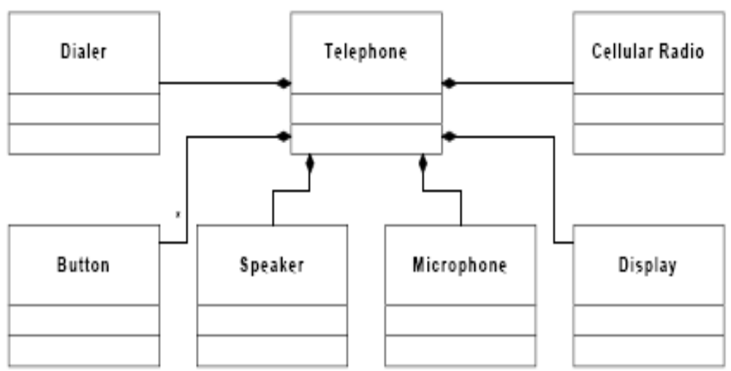
Static model of a Cellular Phone

Slide 29
Class Diagram
Interfaces
<<type>>
ClassName
Interface is an element with all abstract methods (pure virtual functions).
Operation()
The primary icon for an interface is just like a class except that it has a special denotation called a stereotype the «type» string at the top of the class.
The «type» stereotype indicates that the class is an interface. This means that it has no member variables, and that all of its member functions are pure virtual (abstract).

Slide 30
Interfaces
Stereotypes are one of the mechanisms that can be used to extend UML. When a stereotype is used above the name of a class it indicates that this class is a special kind of class that conforms to a rather rigid specification.
The two surrounding characters “«»” are called guillemets (pronounced Gee-may).
A word or phrase surrounded by guillemets is called a “stereotype”.

Slide 31
Interfaces
UML supplies a shortcut for «type» classes. The “lollypop” notation can be used to represent an interface. The dependency between Shape and DrawingContext is shown as usual. The class WindowsDC is derived from the DrawingContext interface. This is a shorthand notation for an inheritance relationship between WindowsDC and DrawingContext.
Shape
WindowsDC
Interface Lollypop
DrawingContext

Slide 32
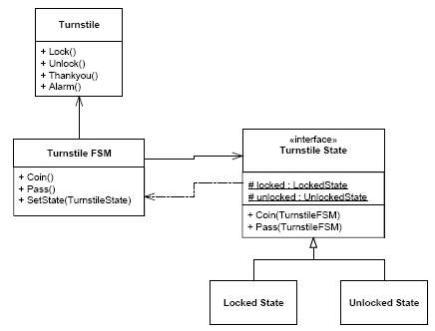
Turnstile FSM designed with the State pattern.

Slide 33
Turnstile FSM implemented using the State pattern.
interface TurnstileState
{
protected static LockedState LOCKED;
protected static UnlockedState UNLOCKED;
public void coin(TurnstileFSM tfsm);
public void pass(TurnstileFSM tfsm);
}

Slide 34
Turnstile FSM implemented using the State pattern.
class LockedState implements TurnstileState
{
public virtual void coin(TurnstileFSM t)
{
………………..
}
public virtual void pass(TurnstileFSM t)
{
……………….
}
}

Slide 35
Turnstile FSM implemented using the State pattern.
class UnlockedState implements TurnstileState
{
public virtual void coin(TurnstileFSM t)
{
………………
}
public virtual void pass(TurnstileFSM t)
{
………………
}
}

Slide 36
Turnstile FSM implemented using the State pattern.
abstract class Turnstile
{
abstract public void lock();
abstract public void unlock();
abstract public void thankyou();
abstract public void lock();
}

Slide 37
Turnstile FSM implemented using the State pattern.
class TurnstileFSM implements Turnstile
{
private TurnstileState itsState;
public void setState(TurnstileState itsState)
{
……………………
}
public void coin()
{
……………………
}
public void pass()
{
……………………
}
}

Slide 38
UML
Package Diagrams
Package Name
Use a tabbed folder to illustrate packages. Similar to classes, you can also list the attributes of a package.
+ ATTRIBUTE 1
# ATTRIBUTE 2
…ATTRIBUTE 3
Package diagrams are a subset of class diagrams, but developers sometimes treat them as a separate technique.
Package diagrams organize elements of a system into related groups to minimize dependencies between packages.

Slide 39
Package Diagrams
PACKAGE NAME
+ATTRIBUTE 1
# ATTRIBUTE 2
…ATTRIBUTE 3
<< import >>
PACKAGE NAME
+ ATTRIBUTE 1
+ ATTRIBUTE 2
…ATTRIBUTE 3
PACKAGE NAME
# ATTRIBUTE 1
# ATTRIBUTE 2
…ATTRIBUTE 3

Slide 40
UML
Object Diagrams
Object Name: CLASS
Object diagrams describe the static structure of a system at a particular time. They can be used to test class diagrams for accuracy.
Attribute Type = ‘Value’
Attribute Type = ‘Value’
Attribute Type = ‘Value’
Object diagrams are also closely linked to class diagrams. Just as an object is an instance of a class, an object diagram could be viewed as an instance of a class diagram.

Slide 41
Object Diagrams
Basic Object Diagram Symbols and Notations
Each object is represented as a rectangle, which contains the name of the object and its class underlined and separated by a colon.
Object name : Class
Named Object
: Class
Unnamed Object
Object name : Class :: Package
Named Object with path name
Active Object :
Objects that control action flow are called active objects. Illustrate these objects with a thicker border.
Object name : Class
Active Object

Slide 42
Object Diagrams
Basic Object Diagram Symbols and Notations
Object with attributes :
Object Name: CLASS
As with classes, you can list object attributes in a separate compartment. However, unlike classes, object attributes must have values assigned to them.
Attribute Type = ‘Value’
Attribute Type = ‘Value’
Attribute Type = ‘Value’
Object with attributes
Multiple Objects :
You can illustrate multiple objects as one symbol if the attributes of the individual objects are not important.
Object name : Class
Multiple Objects

Slide 43
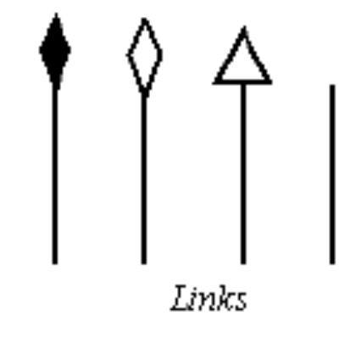
Object Diagrams
Basic Object Diagram Symbols and Notations
Links :
Links are instances of associations. You can draw a link using the lines used in class diagrams.
Self Linked :
Objects that fulfill more than one role can be self-linked.
Object name : Class
Self Linked
Ex: If Mark, an administrative assistant, also fulfilled the role of a marketing assistant, and the two positions are linked, Mark's instance of the two classes will be self-linked.

Slide 44
Object Diagrams
Object Name: CLASS
Attribute Type = ‘Value’
Attribute Type = ‘Value’
Attribute Type = ‘Value’
Object Name: CLASS
Object Name: CLASS
Attribute Type = ‘Value’
Attribute Type = ‘Value’
Attribute Type = ‘Value’
Attribute Type = ‘Value’
Attribute Type = ‘Value’
Attribute Type = ‘Value’
Object Name: CLASS
Object Name: CLASS
Attribute Type = ‘Value’
Attribute Type = ‘Value’
Attribute Type = ‘Value’
Attribute Type = ‘Value’
Attribute Type = ‘Value’
Attribute Type = ‘Value’

Slide 45
UML
Use Case Diagrams
Use case diagrams model the functionality of system using actors and use cases. Use cases are services or functions provided by the system to its users.
USE CASE
USE CASE
USE CASE
<<USES>>
ACTOR
USE CASE

Slide 46
Use Case Diagrams
System:
Draw your system boundaries using a rectangle that contains use cases.
Place actors outside the boundaries.
USE CASE
USE CASE
ACTOR
USE CASE

Slide 47
Use Case Diagrams
Use Case:
Draw use cases using ovals. Label with ovals with verbs that represent the systems’ function
USE CASE
Actor:
Actors are the users of a system. When one system is the actor of another system, label the actor system with the actor stereotype.
ACTOR
<<ACTOR>>
System A

Slide 48
Use Case Diagrams
Relationship:
Illustrate Relationship between an actor and a use case with a simple line. For relationships among use cases, use arrows labeled either “uses” or “extends”.
USE CASE
<<USES>>
ACTOR
USE CASE
<<EXTENDS>>
USE CASE
USE CASE
USES relationship indicates that one use case is needed by another in order to perform a task.
EXTENDS relationship indicates alternative options under a certain use case.

Slide 49
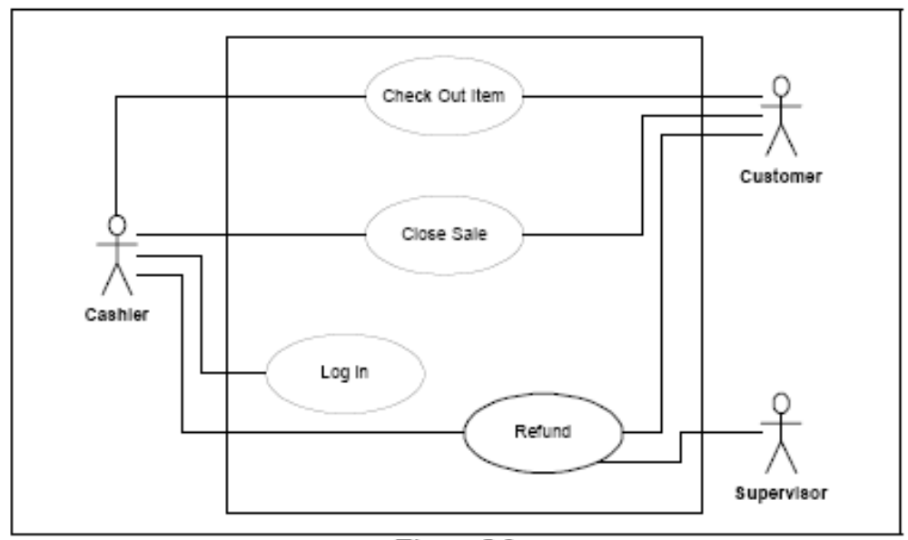
System Boundary Diagram

Slide 50
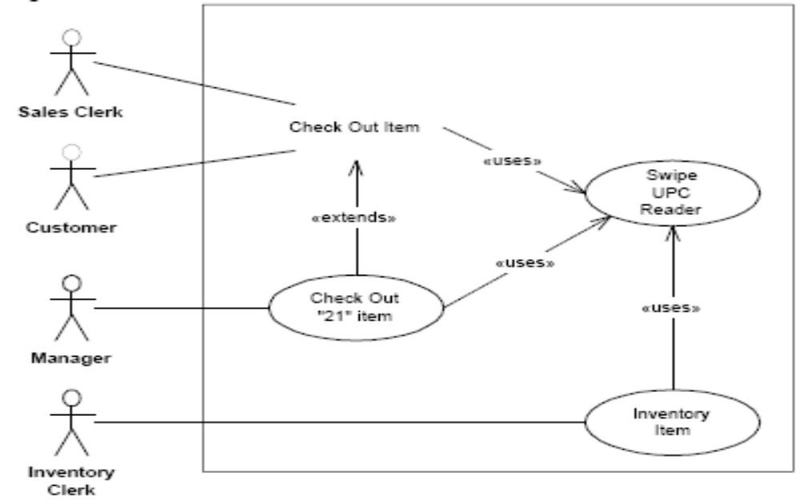
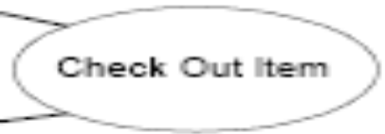
System Boundary Diagram

Slide 51
Use Case Diagrams
The one thing to remember about use cases is, tomorrow they are going to change.
No matter how diligently you capture them
No matter how fastidiously you record the details
No matter how thoroughly you think them through
No matter how much effort you apply to exploring and analyzing the requirements
tomorrow they are going to change.
Think of use cases as: Just In Time Requirements.

Slide 52
Use Case Diagrams
A use case is a description of the behavior of a system. That description is written from the point of view of a user who has just told the system to do something particular.
Use cases don’t discuss the hidden mechanisms of the system. They only describe those things that a user can see.
Of all the diagrams in UML, use case diagrams are the most confusing, and the least useful.

Slide 53
Use Case Diagrams
Use Case Relationships
Use case relationships fall into the category of things that “seemed like a good idea at the time”.
They’ll add no value to your use cases, or to your understanding of the system, and they will be the source of many never ending debates about whether or not to use «extends» or «generalization».
It is better to ignore the Use Case relationships.

Slide 54
UML
Sequence Diagrams
Sequence diagrams describe interactions among classes in terms of an exchange of messages over time.
Object: Class
Object: Class
ACTOR
[condition]
Message Name
[condition]
Message Name
[condition]
Message Name

Slide 55
Sequence Diagrams
Class roles describe the way an object will behave in context. Use the UML object symbol to illustrate class roles, but don't list object attributes.
Object: Class
Object: Class
Object: Class
ACTOR
Activation
boxes represent the time an object needs to complete a task.
Activations

Slide 56
Sequence Diagrams
Messages are arrows that represent communication between objects.
Use half-arrowed lines to represent asynchronous messages.
Asynchronous messages are sent from an object that will not wait for a response from the receiver before continuing
Object: Class
Object: Class
ACTOR
Messages
Simple
Synchronous
Asynchronous
Balking
Time out

Slide 57
Sequence Diagrams
Object: Class
Object: Class
Lifelines are vertical dashed lines that indicate the object's presence over time.
ACTOR
Object: Class
ACTOR
Lifelines
Destroying Objects can be terminated early using an arrow labeled "<<destroy>>" that points to an X.
<<destroy>>

Slide 58
Sequence Diagrams
Object: Class
Object: Class
ACTOR
Loops A repetition or loop within a sequence diagram is depicted as a rectangle. Place the condition for exiting the loop at the bottom left corner in square brackets [ ]
[condition to exit]
Loop

Slide 59
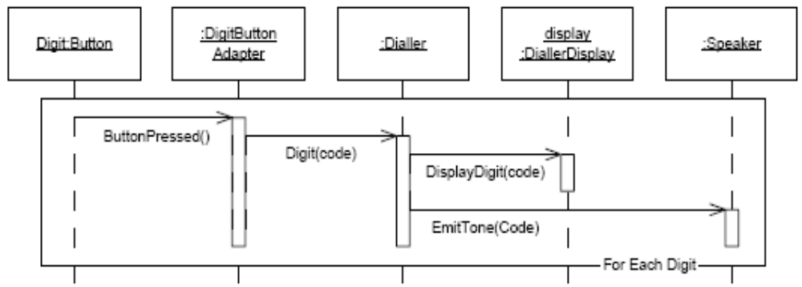
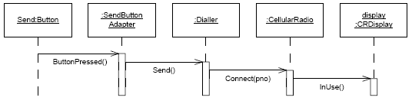

Slide 60
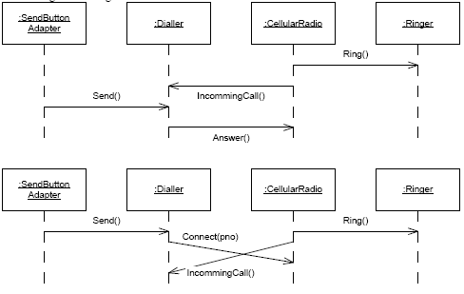
Race condition between dialing and answering.

Slide 61
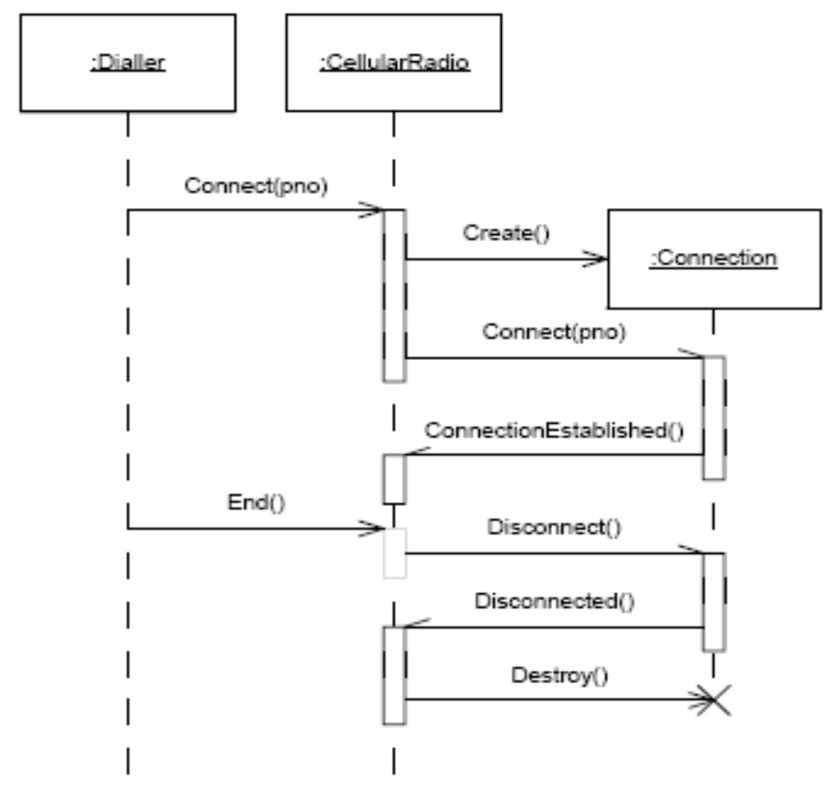
Asynchronous Messages and Concurrency

Slide 62
UML
Collaboration Diagrams: Collaboration diagrams represent interactions between objects as a series of sequenced messages. Collaboration diagrams represent a combination of information taken from class, sequence, and use case diagrams describing both the static structure and dynamic behavior of a system.
Object: Class
1.2 [condition]
Message
1. message
2. message
Object: Class
Object: Class
ACTOR
2.3 [condition]
Message
Object: Class

Slide 63
Collaboration Diagrams
Class roles describe how objects behave. Use the UML object symbol to illustrate class roles, but don't list object attributes.
Object: Class
Association roles describe how an association will behave given a particular situation. You can draw association roles using simple lines labeled with stereotypes.
<<global>>

Slide 64
Collaboration Diagrams
Messages Unlike sequence diagrams, collaboration diagrams do not have an explicit way to denote time and instead number messages in order of execution. Sequence numbering can become nested using the Dewey decimal system. For example, nested messages under the first message are labeled 1.1, 1.2, 1.3, and so on. The a condition for a message is usually placed in square brackets immediately following the sequence number. Use a * after the sequence number to indicate a loop.
1.2 [condition]: message name
1.2 * [loop expression]: message name

Slide 65
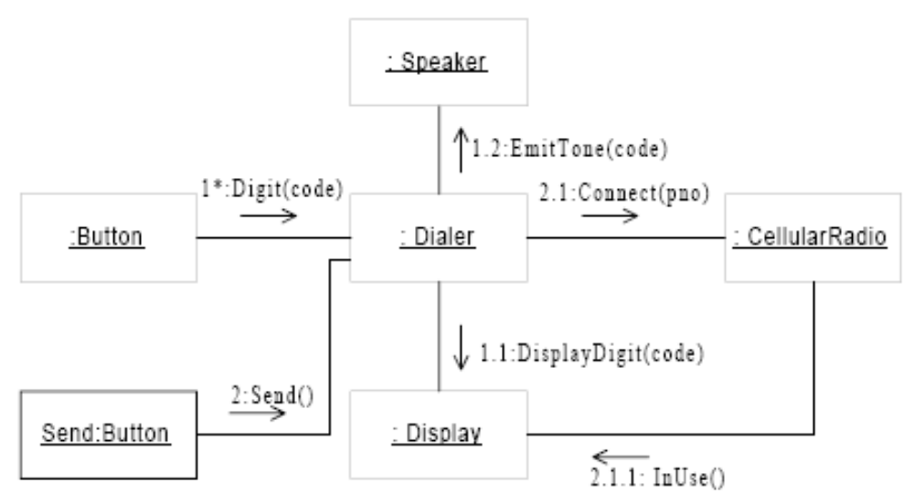
Collaboration Diagram of “Make Phone Call” use case.

Slide 66
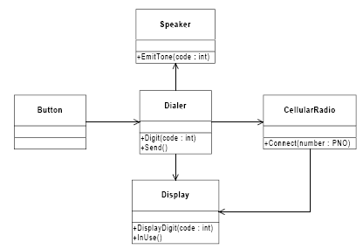
Reconciled static model

Slide 67
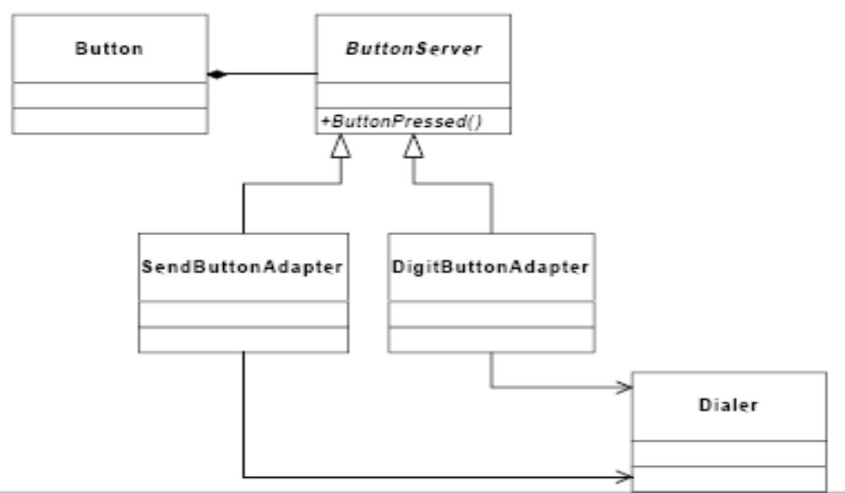
ADAPTED SERVER pattern for decoupling Button from Dialer

Slide 68
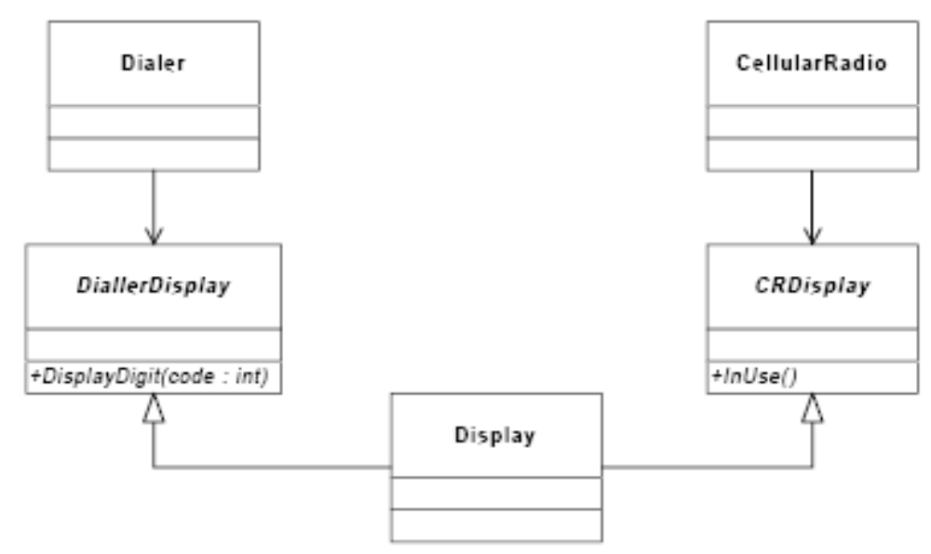
Interface Segregation of the Display

Slide 69
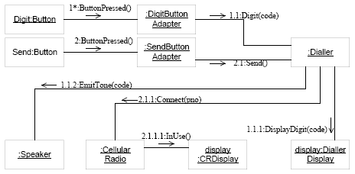
Iterated Dynamic Model

Slide 70
UML
State chart Diagrams:
State chart diagrams describe the dynamic behavior of a system in response to external stimuli. This diagram models the dynamic flow of control from state to state within a system.
State chart diagrams are especially useful in modeling reactive objects whose states are triggered by specific events.

Slide 71
State chart Diagrams
State
Do / Activity
State
Do / Activity
Event / Action
Event / Action
State
Do / Activity
State
Do / Activity
Event / Action

Slide 72
State chart Diagrams
States represent situations during the life of an object. You can easily illustrate a state in SmartDraw by using a rectangle with rounded corners.
State
Do / Activity
Transition A solid arrow represents the path between different states of an object. Label the transition with the event that triggered it and the action that results from it.
Event/action
Event/action

Slide 73
State chart Diagrams
Initial State A filled circle followed by an arrow represents the object's initial state.
Final State An arrow pointing to a filled circle nested inside another circle represents the object's final state.
Synchronization and Splitting of Control A short heavy bar with two transitions entering it represents a synchronization of control. A short heavy bar with two transitions leaving it represents a splitting of control that creates multiple states.
Synchroni
zation
Splitting of
Control

Slide 74
UML
Activity Diagrams:
Activity diagrams illustrate the dynamic nature of a system by modeling the flow of control from activity to activity.
An activity represents an operation on some class in the system that results in a change in the state of the system.
Typically, activity diagrams are used to model workflow or business processes and internal operation.

Slide 75
Activity Diagrams
:Class
:Class
:Class
Activity
Activity
:Class
Activity
:Class

Slide 76
Activity Diagrams
Initial State A filled circle followed by an arrow represents the initial action state.
Final State An arrow pointing to a filled circle nested inside another circle represents the final
Object Flow refers to the creation and modification of objects by activities. An object flow arrow from an action to an object means that the action creates or influences the object. An object flow arrow from an object to an action indicates that the action state uses the object.
Activity
Object name : Class

Slide 77
Activity Diagrams
Action states represent the no interruptible actions of objects. You can draw an action state in SmartDraw using a rectangle with rounded corners.
Activity
Activity
Action Flow arrows illustrate the relationships among action states.
Activity
Branching A diamond represents a decision with alternate paths. The outgoing alternates should be labeled with a condition or guard expression. You can also label one of the paths “else”
Activity
[condition]
Activity
[condition]
Activity

Slide 78
Activity Diagrams
Activity
Synchronization bar helps illustrate parallel transitions. Synchronization is also called forking and joining.
Activity
Activity
swim lane 1
swim lane 2
Activity
Activity
Object : Class
Swim lanes group related activities into one column.
Activity

Slide 79
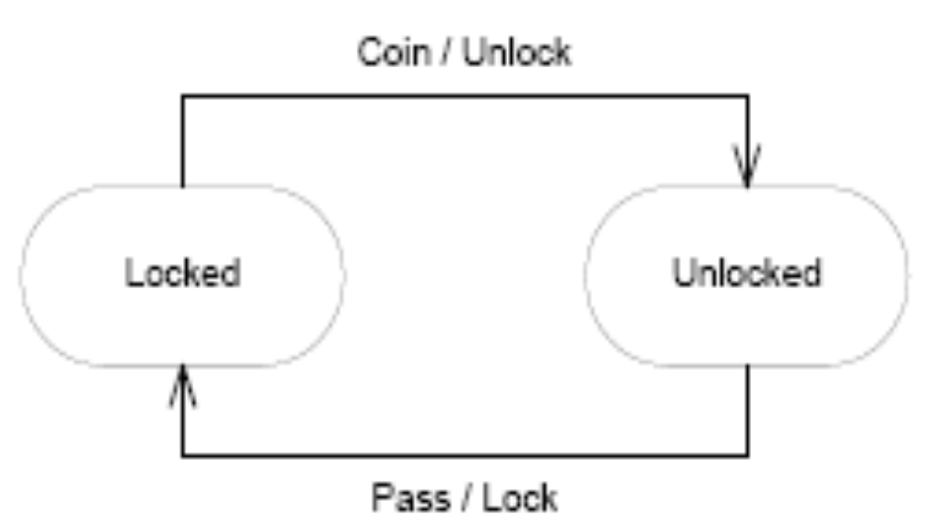
Subway Turnstile

Slide 80
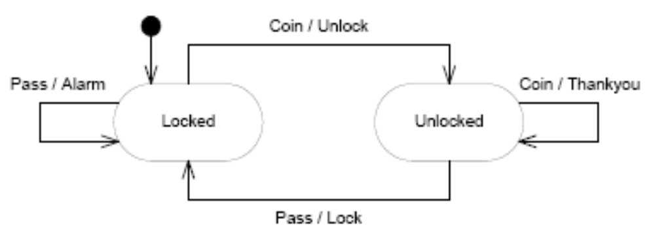
Turnstile with abnormal events.

Slide 81
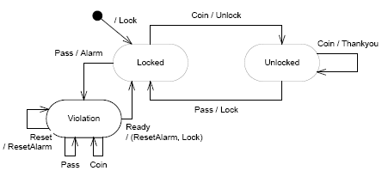
Turstile with Violation state

Slide 82
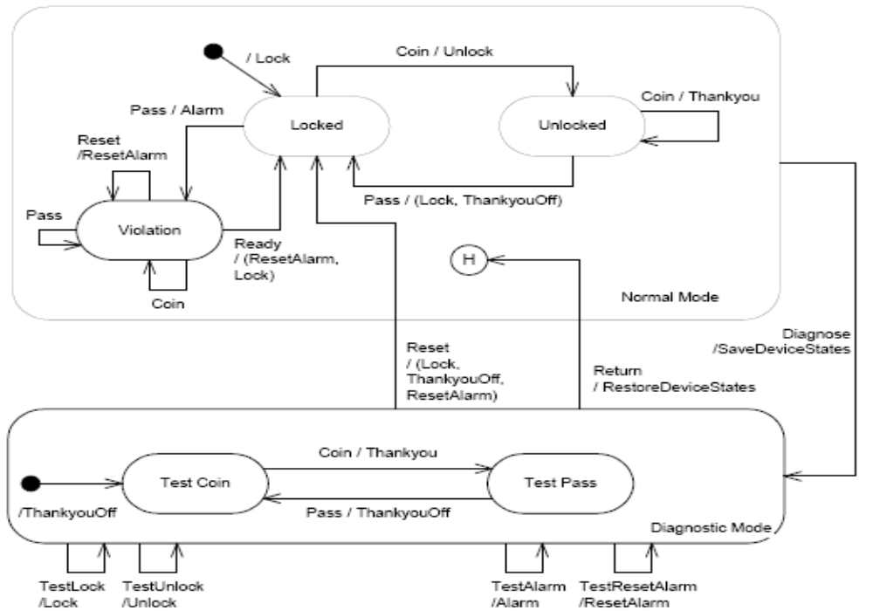
Turnstile with Diagnostic Mode

Slide 83
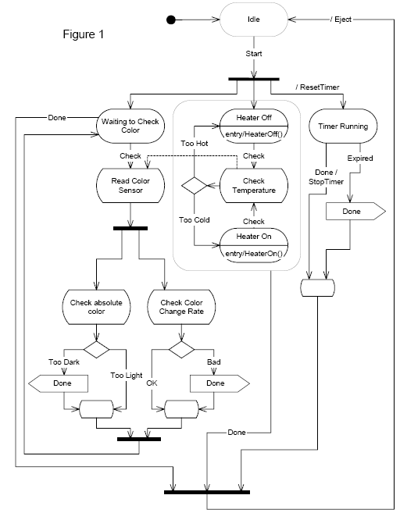

Slide 84
UML
Component Diagrams
Component diagrams describe the organization of physical software components, including source code, run-time (binary) code, and executables.
Component
Component
Component

Slide 85
Component Diagrams
Component is a physical building block of the system. It is represented as a
Component
Interface describes a group of operations used or created by components.
Component
Dependencies Draw Dependencies among components using dashed arrows.
Component
Dependency
Component

Slide 86
UML
Deployment Diagrams depict the physical resources in a system, in nodes, components and connections.
Node Name
Component
Component
Node Name
Component
Node Name
Component
Component
Component

Slide 87
Deployment Diagrams
Node is a physical resource that executes code components.
Node Name
Association refers to a physical connection between nodes, such as Ethernet.
Node
Node
Components and Nodes
Place components inside the node that deploys them.
Server
Component
Component

Slide 88
CASE STUDY

Slide 89
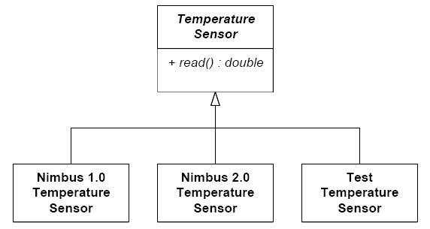
Initial Temperature Sensor Design.

Slide 90
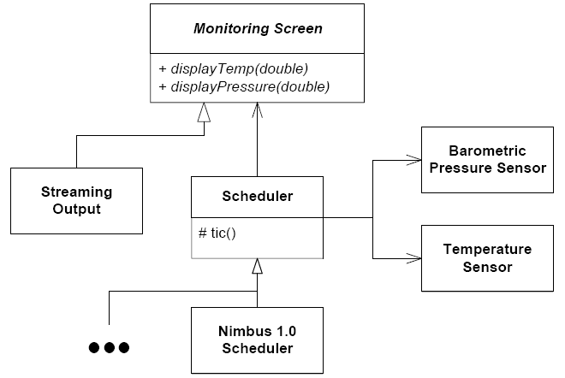
Initial Scheduler and Display architecture

Slide 91
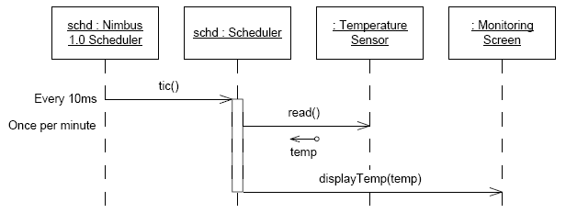
Initial Scheduler Sequence Diagram

Slide 92
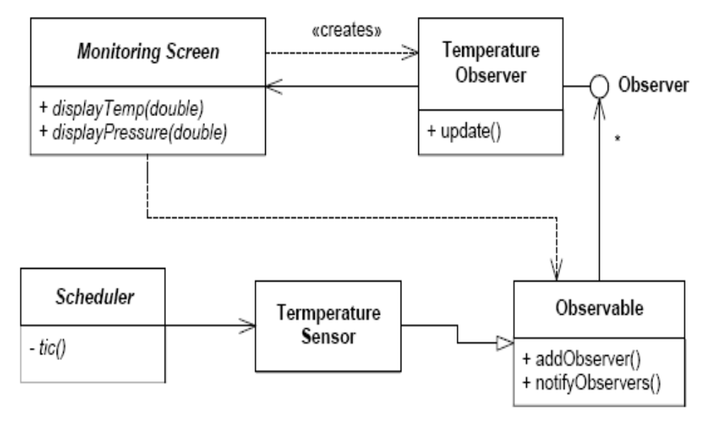
Observer decouples UI from Scheduler.

Slide 93
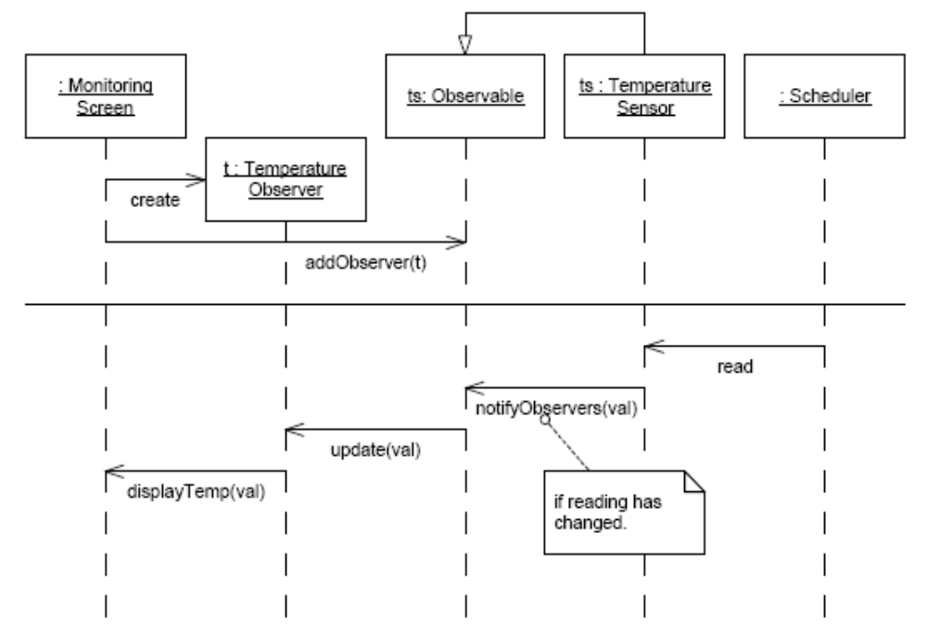
Decoupled UI sequence diagram

Slide 94
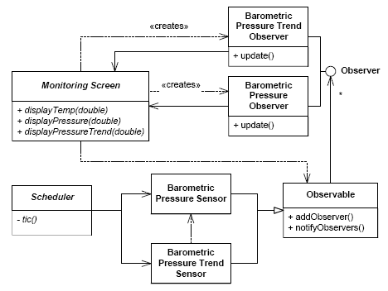
Barometric Pressure Observers

Slide 95
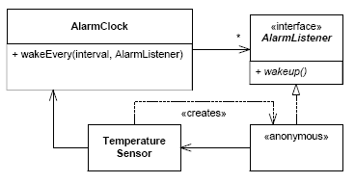
Decoupled Alarm clock

Slide 96
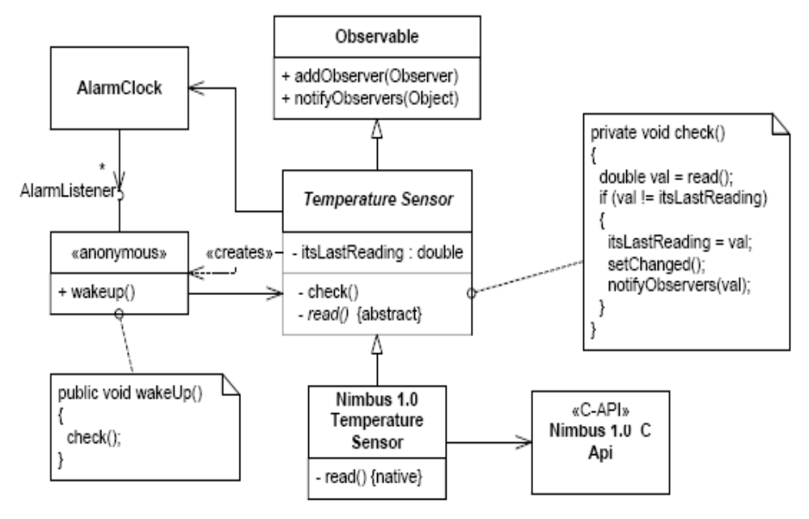
Sensor Structure

Slide 97
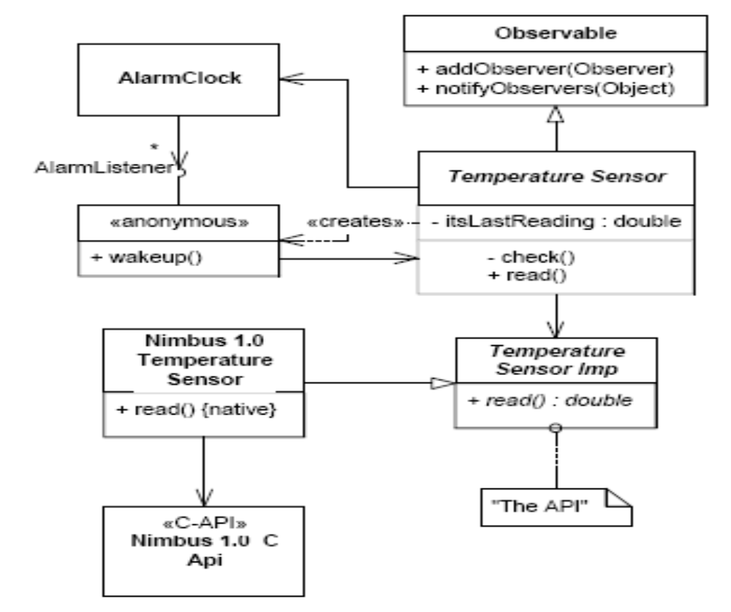
Temperature Sensor with API

Slide 98
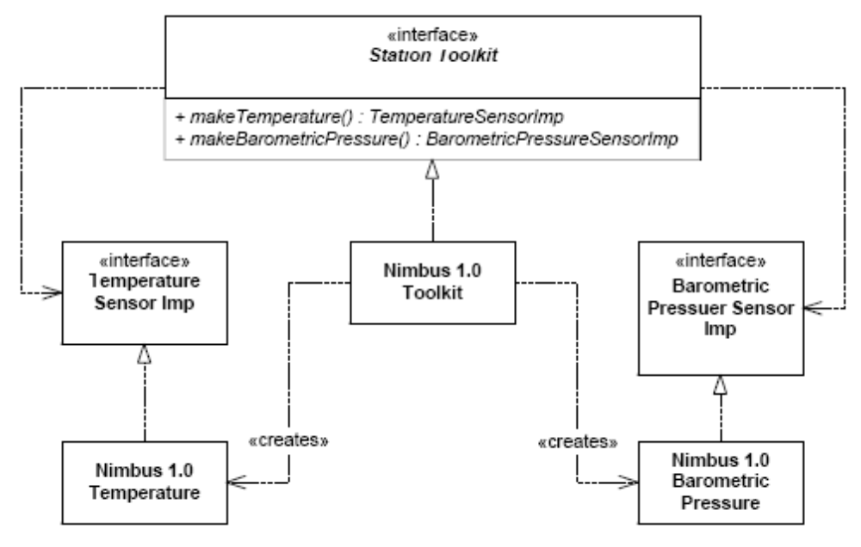
Station Toolkit

Slide 99
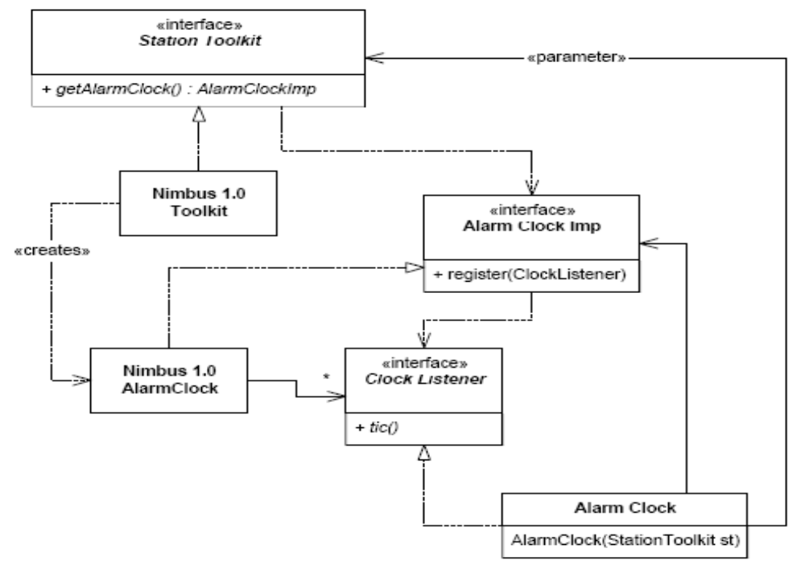
Station Toolkit and Alarm Clock

Slide 100
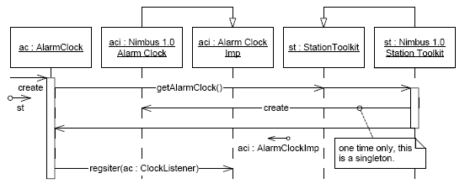
Creation of the Alarm Clock

Slide 101
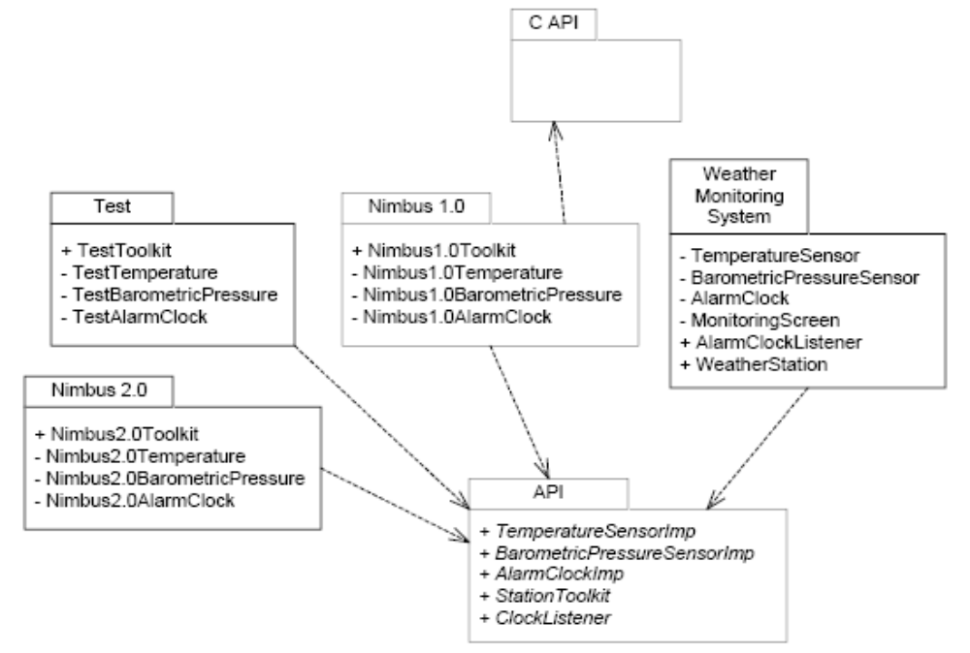
Phase I Package Structure

Slide 102
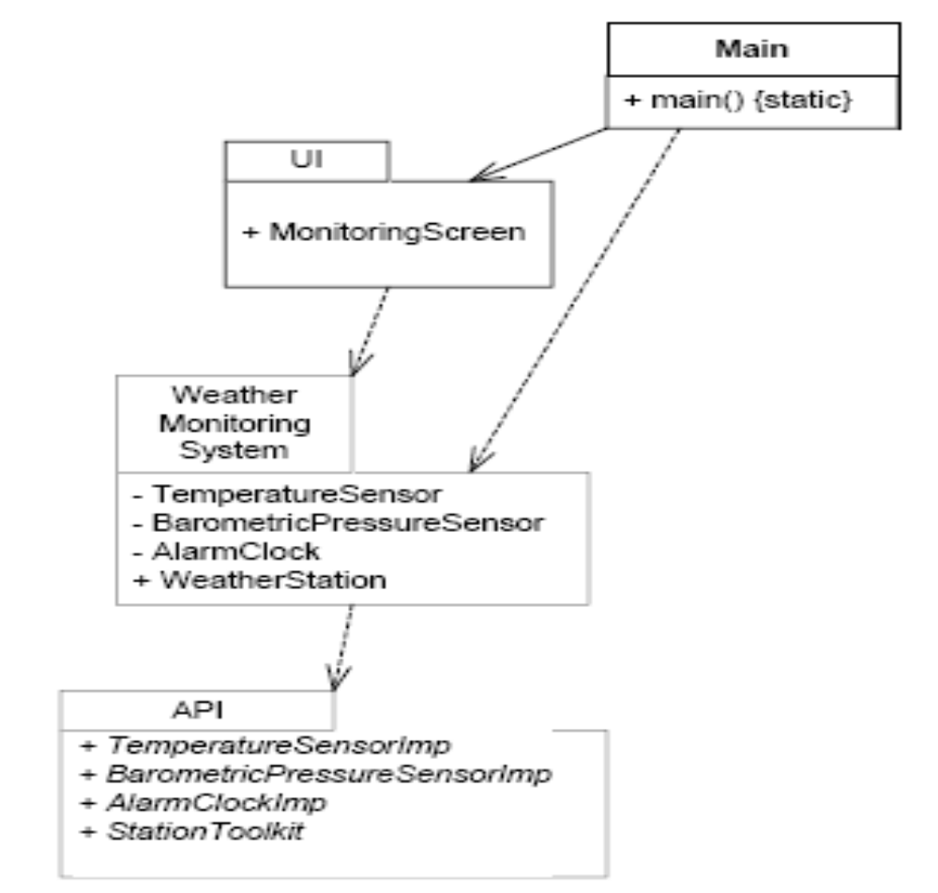
Package Diagram with Cycle Broken

Slide 103
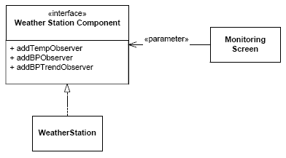
Weather Station abstract interface

Slide 104
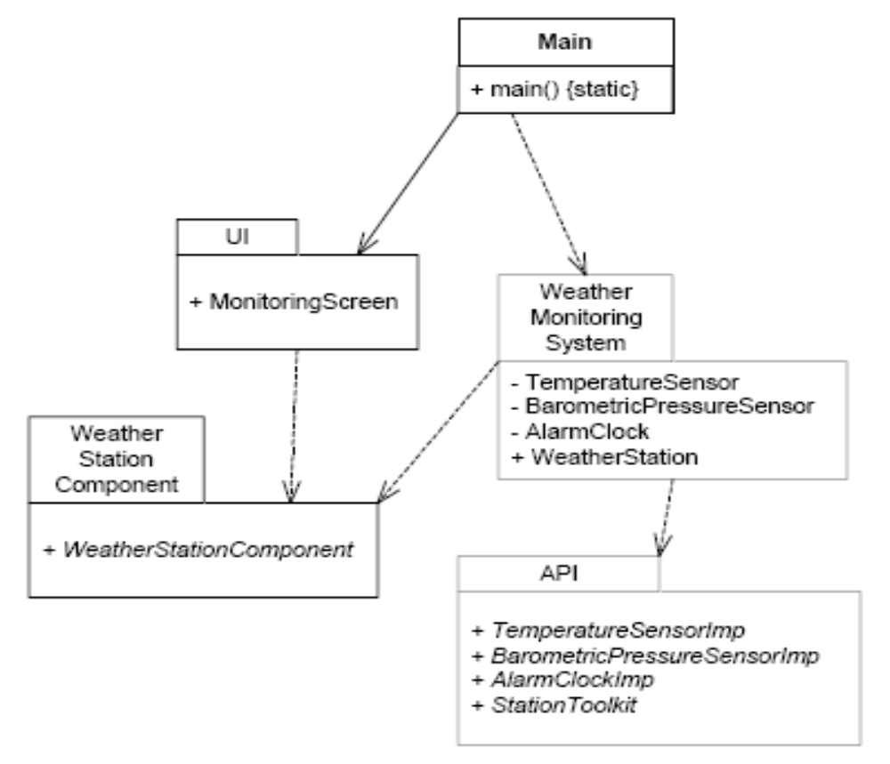
Weather Station Component Package Diagram

Slide 105
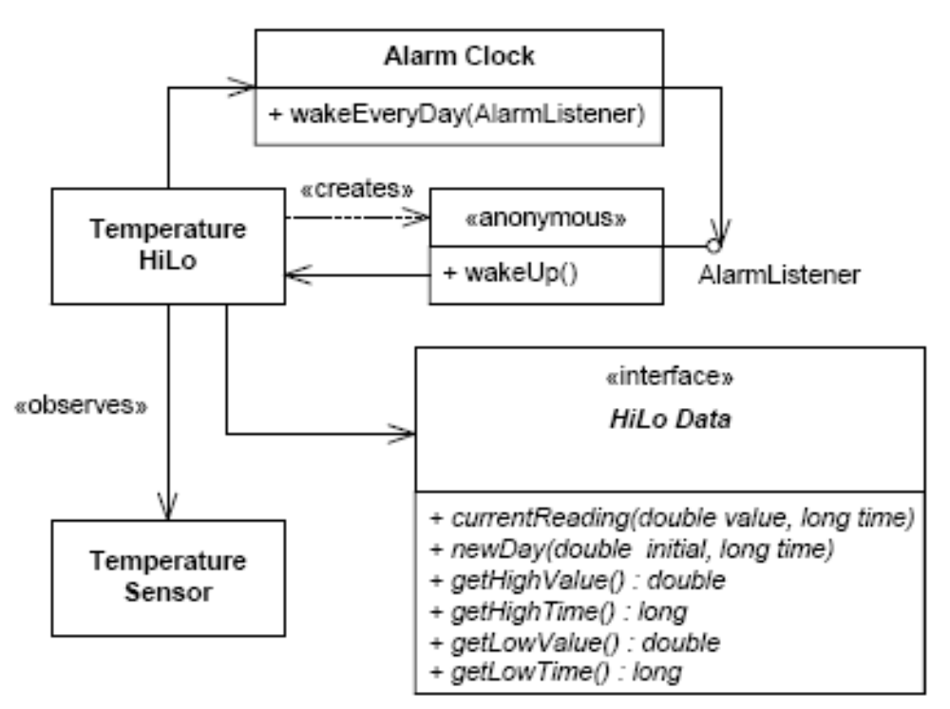
Temperature Hi Lo structure.

Slide 106
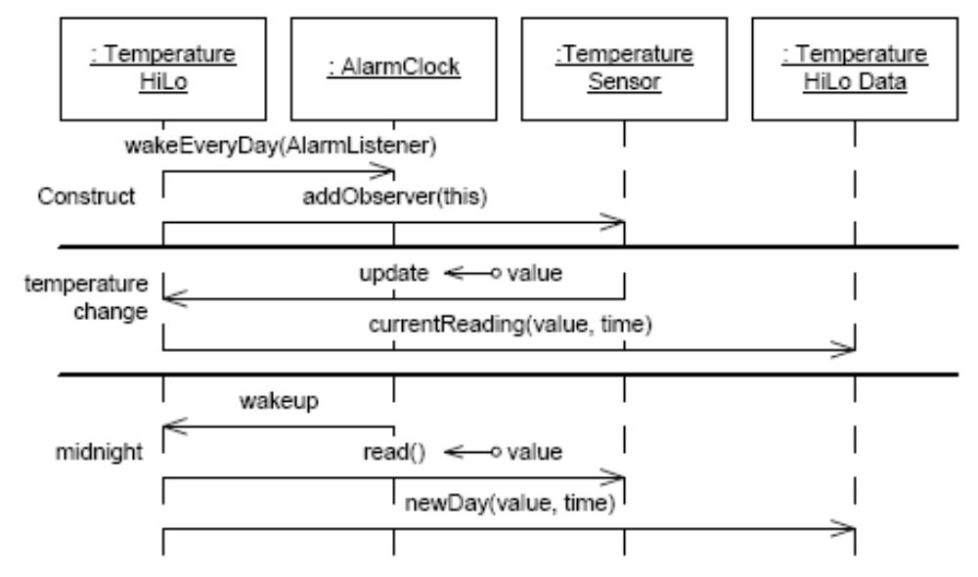
Hi Lo Scenarios.

Slide 107
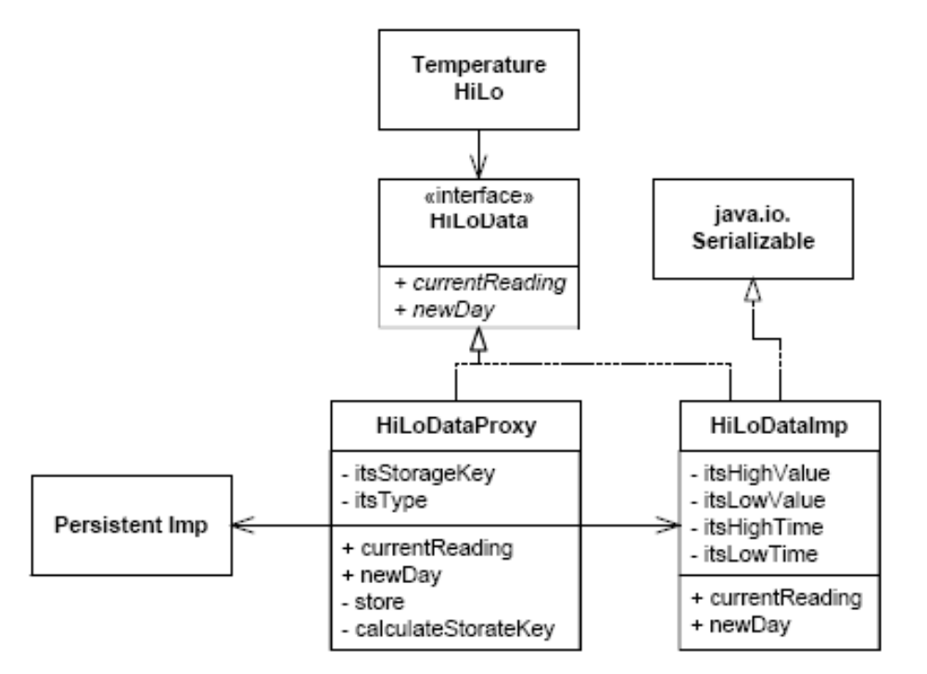
Proxy pattern applied to HiLo persistence.

Slide 108
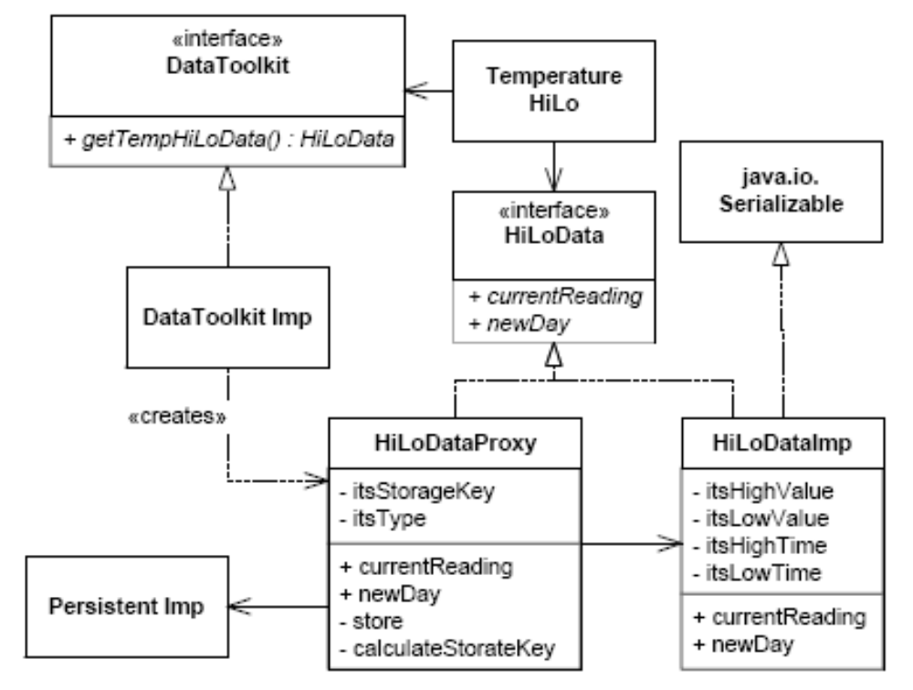
Using Abstract Factory to create the Proxy.

Slide 109
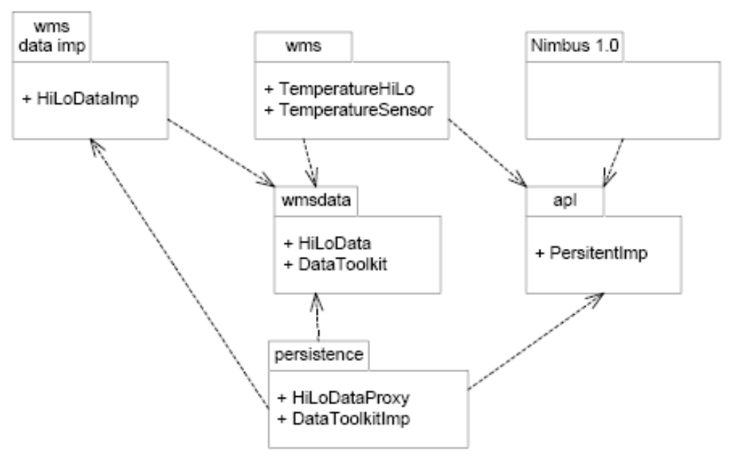
Proxy and Factory package structure

Slide 110
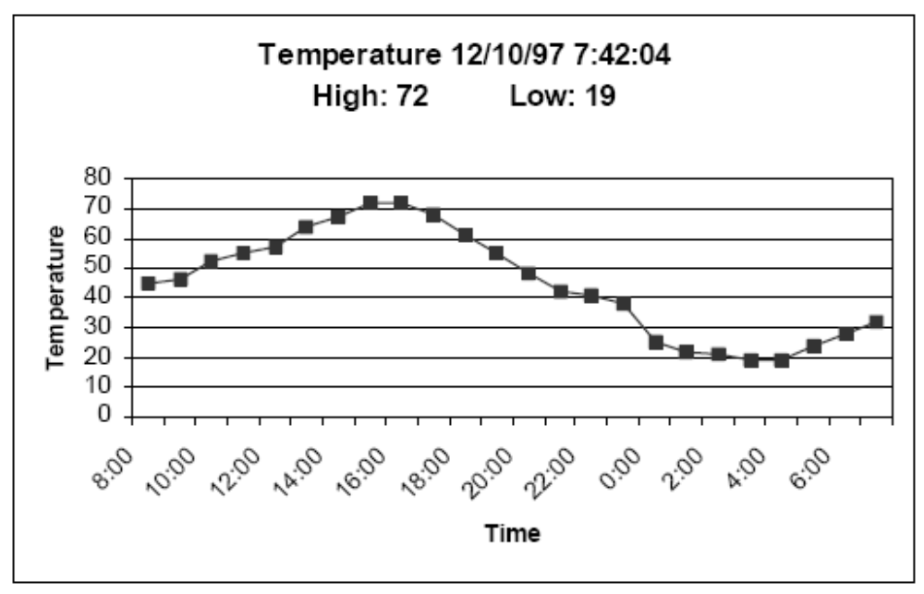
Temperature History

Slide 111
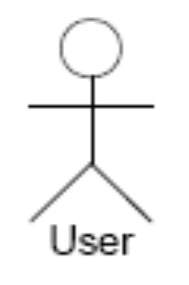

Actors

Slide 112
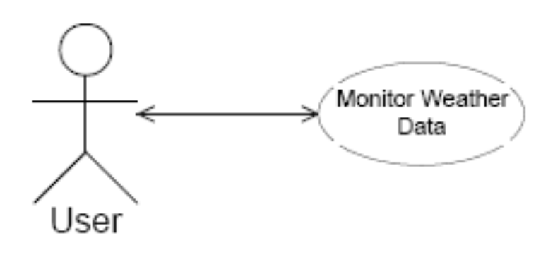
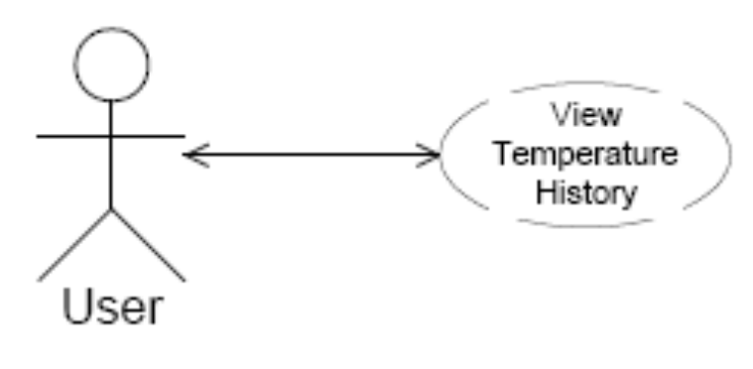
Use Cases

Slide 113
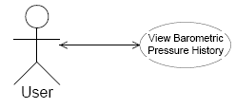
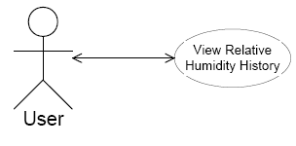
Use Cases

Slide 114
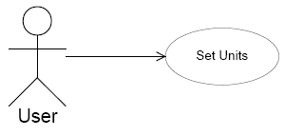
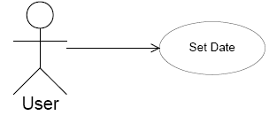
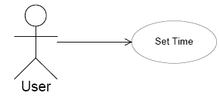
Use Cases

Slide 115


Use Cases

Slide 116


Use Cases

Slide 117


Use Cases

Slide 118


Use Cases

